Slide 1



Slide 2

WEEKLY NIFTY & BANK NIFTY VIEW
Presented By-Mr. Ratnesh Goyal
(Sr. Technical Analyst)

Slide 3

NIFTY OUTLOOK
If we look at the daily chart of Nifty we are observing that nifty is trading in a channel and facing resistance from the higher level of 50 SMA and on weekly chart we are observing a “DOJI” candlestick formation. It indicate we may see some limited upside movement in the market. Nifty can face resistance around 18,080 level if it start trade above then it can touch 18,250-18,400 levels, while on the downside support is 17,800 if it start trade below then it can test the level of 17,600 and 17,450 levels.

Slide 4
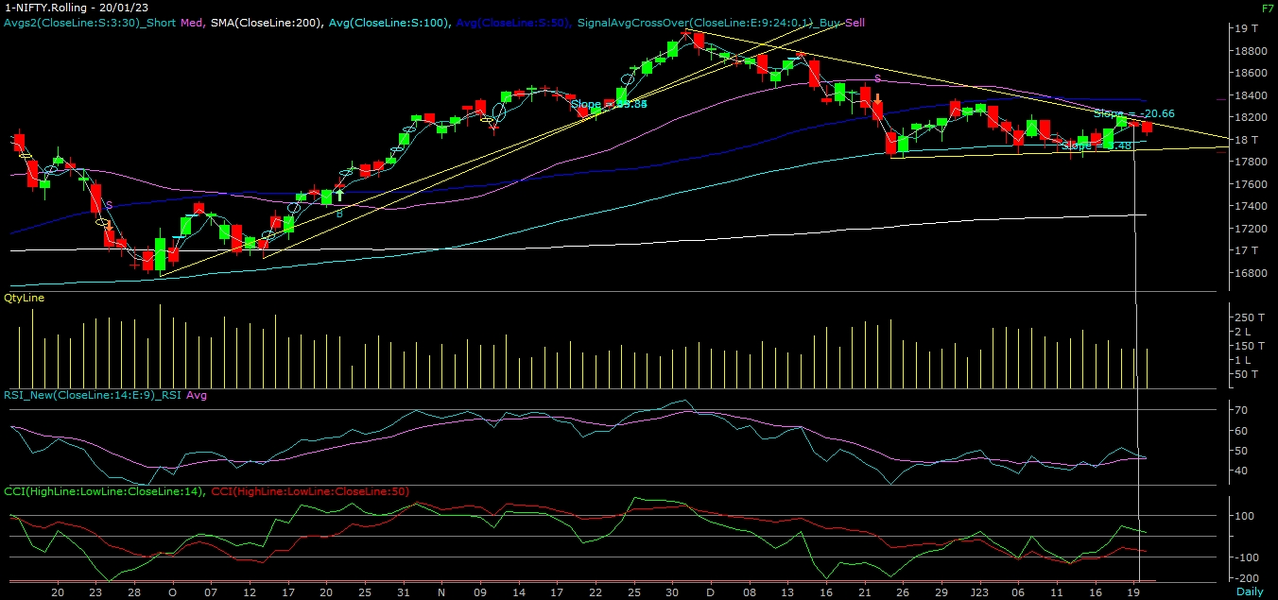
NIFTY

Slide 5
NIFTY BANK OUTLOOK
If we look at the daily and as weekly chart of Bank-Nifty we are observing a series of narrow range body formation. If we analyzed both chart then it seems that we can see some consolidation from the higher level in the coming trading session if it trade above 42,620 then it can touch 42,850 and 43,100 levels, however downside support comes at 42,300 below that we can see 41,800-41,500 levels.

Slide 6
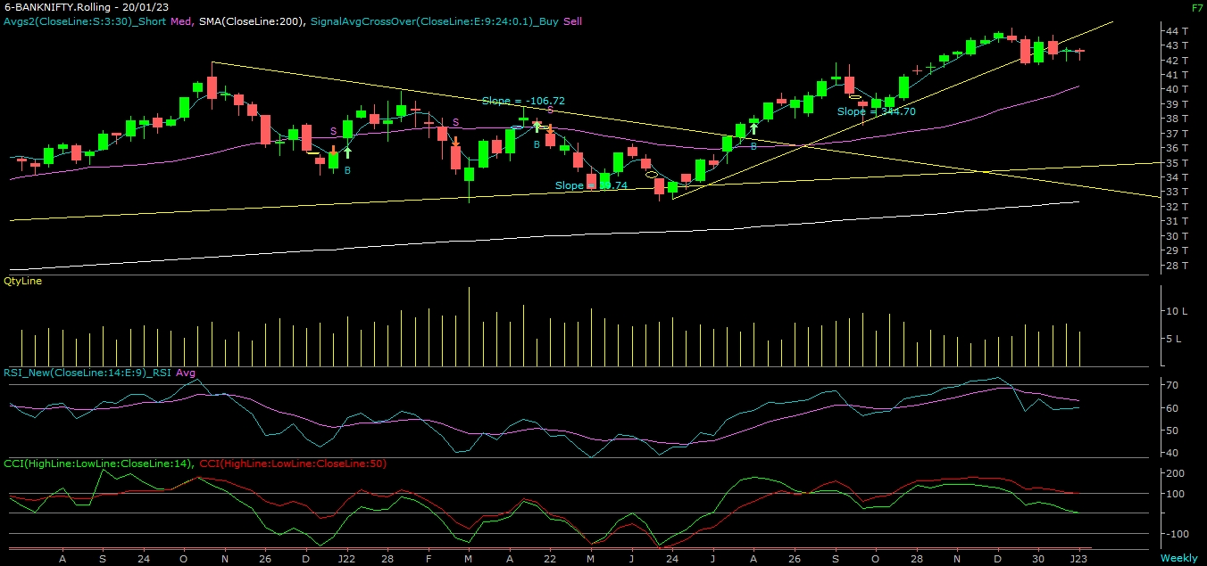
BANK NIFTY

Slide 7
FINAL SUMMARY
NIFTY BANK NIFTY Resistance – 18250-18400 Resistance – 42850 - 43100
Support – 17600-17450 Support – 41800 - 41500

