Slide 1



Slide 2

WEEKLY NIFTY & BANK NIFTY VIEW
Presented By-Mr. Ratnesh Goyal
(Sr. Technical Analyst)

Slide 3

NIFTY OUTLOOK
If we look at the daily chart of Nifty we are observing an “Upward gap area” and on the weekly chart we are observing a breakout of consolidation, If we analyze both chart patterns it indicates we may see stock-specific action with a positive bias and still use any correction as a buying opportunity. if Nifty starts trading above the 22,450 level, then it can touch the 22,750-23,000 level, while on the downside, support is 22,150 and if it starts to trade below then it can test the level 21,850 and 21,600 levels.

Slide 4
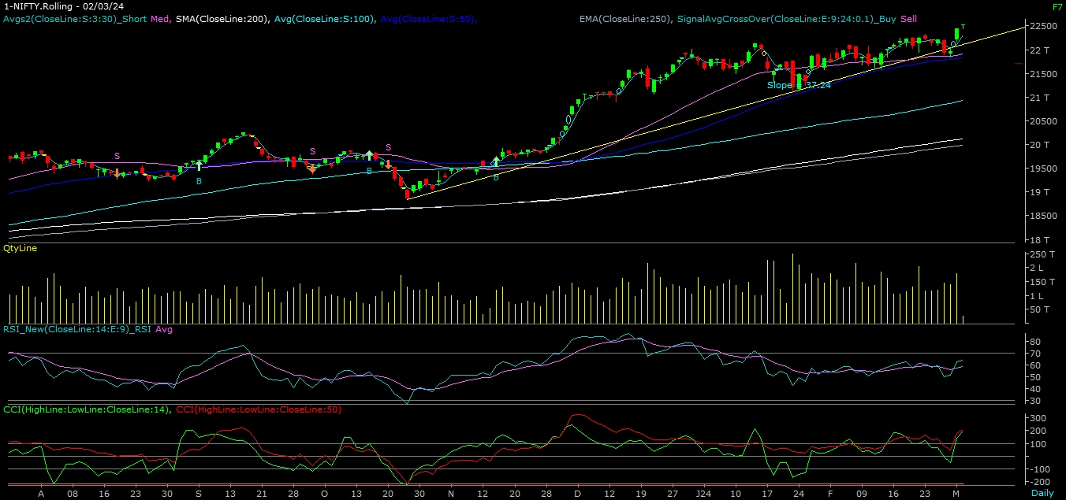
NIFTY

Slide 5
NIFTY BANK OUTLOOK
If we look at the daily chart of Bank-Nifty, we are observing an “Upward gap area” and on the weekly chart we are observing a “Hammer” candlestick formation, if we analyze both chart patterns it indicates Bank-nifty can outperform Nifty. Bank-nifty starts trades above 47,450 then it can touch 47,800 and 48,000 levels. However, downside support comes at 47,100, and below that, we can see 46,750 and 46,500 levels.

Slide 6
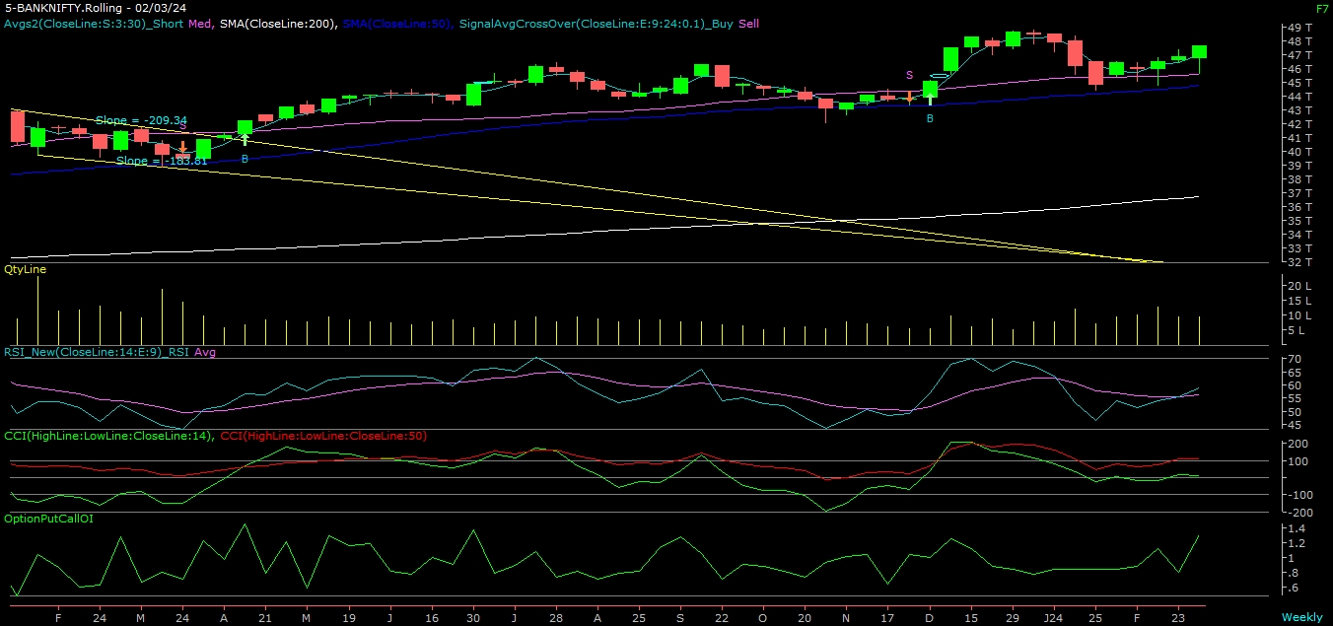
BANK NIFTY

Slide 7
FINAL SUMMARY
NIFTY BANK NIFTY Resistance – 22750-22300 Resistance – 47800 - 48000
Support – 21850-21600 Support – 46750 - 46500

