Slide 1



Slide 2

WEEKLY NIFTY & BANK NIFTY VIEW
Presented By-Mr. Ratnesh Goyal
(Sr. Technical Analyst)

Slide 3

NIFTY OUTLOOK
If we look at the daily chart of Nifty, we are observing a “ Series of Narrow range body” formation, and on the weekly chart we are observing a “ Flag pattern” formation, If we analyze both chart patterns it indicates, that we may see positive trend remains continues and still you can use buy on dip strategy. if Nifty starts trading above the 24,350 level, then it can touch the 24,500-24,650 level, while on the downside, support is 24,100 and if it starts to trade below then it can test the level 23,900 and 23,700 levels.

Slide 4
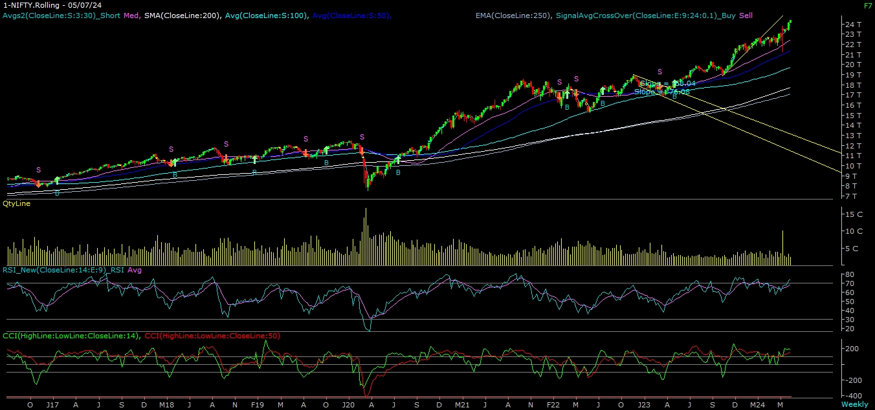
NIFTY

Slide 5
NIFTY BANK OUTLOOK
If we look at the daily and weekly chart of Bank-Nifty, we are observing “DOJI” candlestick formation, if we analyze both chart patterns it indicates Bank-Nifty can consolidate. If Bank-nifty starts trades above 52,800 then it can touch 53,300 and 53,500 levels. However, downside support comes at 52,300, and below that, we can see 51,800 and 51,500 levels.

Slide 6
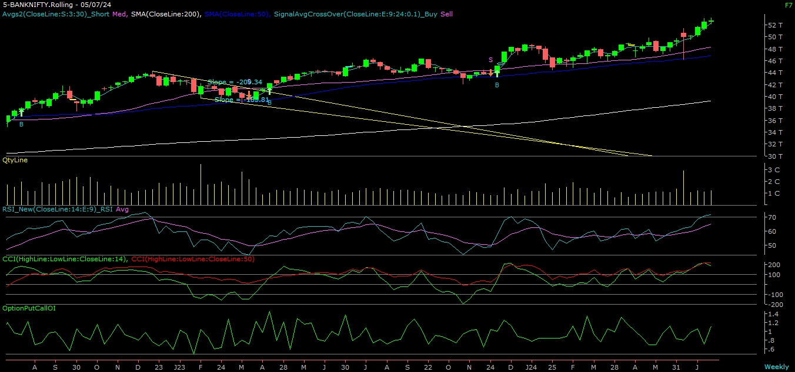
BANK NIFTY

Slide 7
FINAL SUMMARY
NIFTY BANK NIFTY Resistance – 24500-24650 Resistance – 53300 - 53500
Support – 23900-23700 Support – 51800 - 51500

