Slide 1



Slide 2

WEEKLY NIFTY & BANK NIFTY VIEW
Presented By-Mr. Ratnesh Goyal
(Sr. Technical Analyst)

Slide 3

NIFTY OUTLOOK
If we look at the daily chart of Nifty we are observing an “Upward gap area” and on the weekly chart we are observing “DOJI” candlestick formation, If we analyze both chart patterns it indicates we may see stock-specific action with positive bias and still use any correction as a buying opportunity. if Nifty starts trading above the 22,550 level, then it can touch the 22,750-23,000 level, while on the downside, support is 22,350 and if it starts to trade below then it can test the level 22,150 and 22,000 levels.

Slide 4
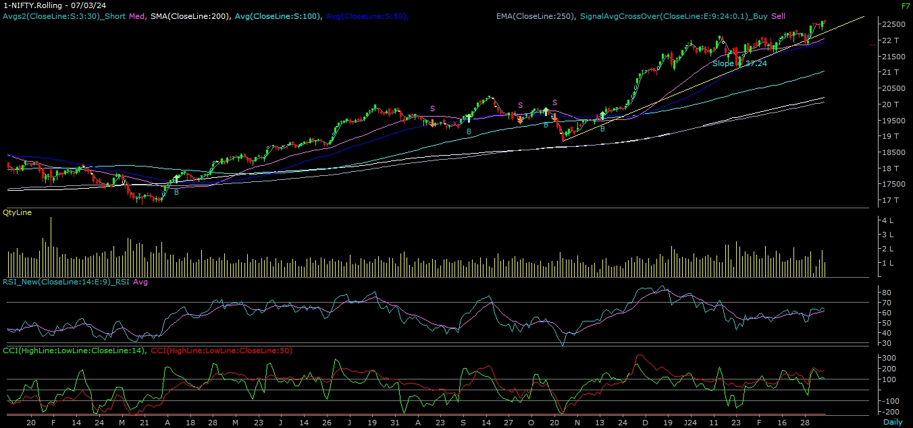
NIFTY

Slide 5
NIFTY BANK OUTLOOK
If we look at the daily chart of Bank-Nifty, we are observing an “Upward gap area” and on the weekly chart we are observing a “Narrow Range” body formation, if we analyze both chart patterns it indicates Bank-nifty can outperform Nifty. Bank-nifty starts trades above 47,880 then it can touch 48,100 and 48,500 levels. However, downside support comes at 47,500, and below that, we can see 47,100 and 46,800 levels.

Slide 6
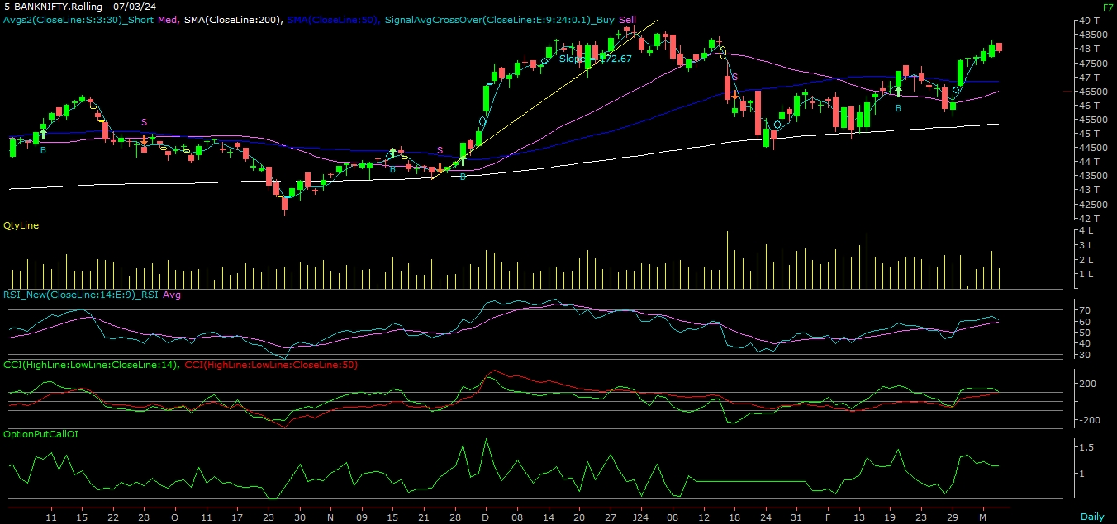
BANK NIFTY

Slide 7
FINAL SUMMARY
NIFTY BANK NIFTY Resistance – 22750-23000 Resistance – 48100 - 48500
Support – 22150-22000 Support – 47100 - 46800

