Slide 1



Slide 2

WEEKLY NIFTY & BANK NIFTY VIEW
Presented By-Mr. Ratnesh Goyal
(Sr. Technical Analyst)

Slide 3

NIFTY OUTLOOK
If we look at the daily chart of Nifty we are observing prices tested 50 DAY moving averages and on the weekly chart we are observing a “Break-down” of a trend line, If we analyze both chart patterns it indicates we may have some pressure from a higher level, but still stocks specific action may remain to continue. if Nifty starts trading above the 22,080 level, then it can touch the 22,150-22,300 level, while on the downside, support is 21,950 and if it starts to trade below then it can test the level 21,800 and 21,650 levels.

Slide 4
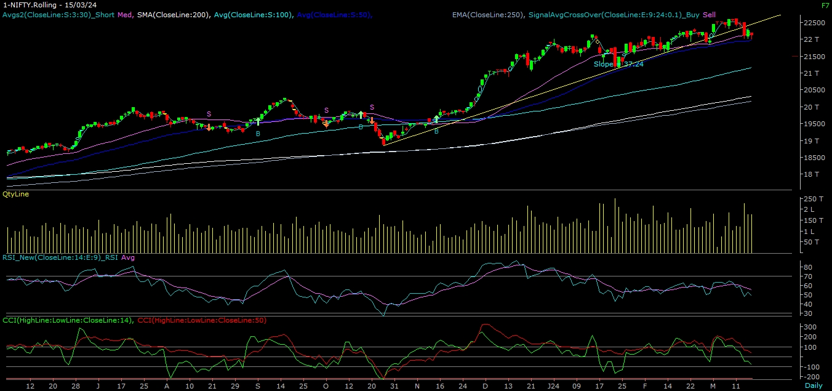
NIFTY

Slide 5
NIFTY BANK OUTLOOK
If we look at the daily chart of Bank-Nifty, we are observing prices close below “Short-term “ moving averages, but on the weekly chart still trading above “Short-term term” moving averages, if we analyze both chart patterns it indicates Bank-nifty can consolidate and can see underperformance compare to. Bank-nifty starts trades above 46,650 then it can touch 46,850 and 47,050 levels. However, downside support comes at 46,500, and below that, we can see 46,300 and 46,100 level

Slide 6
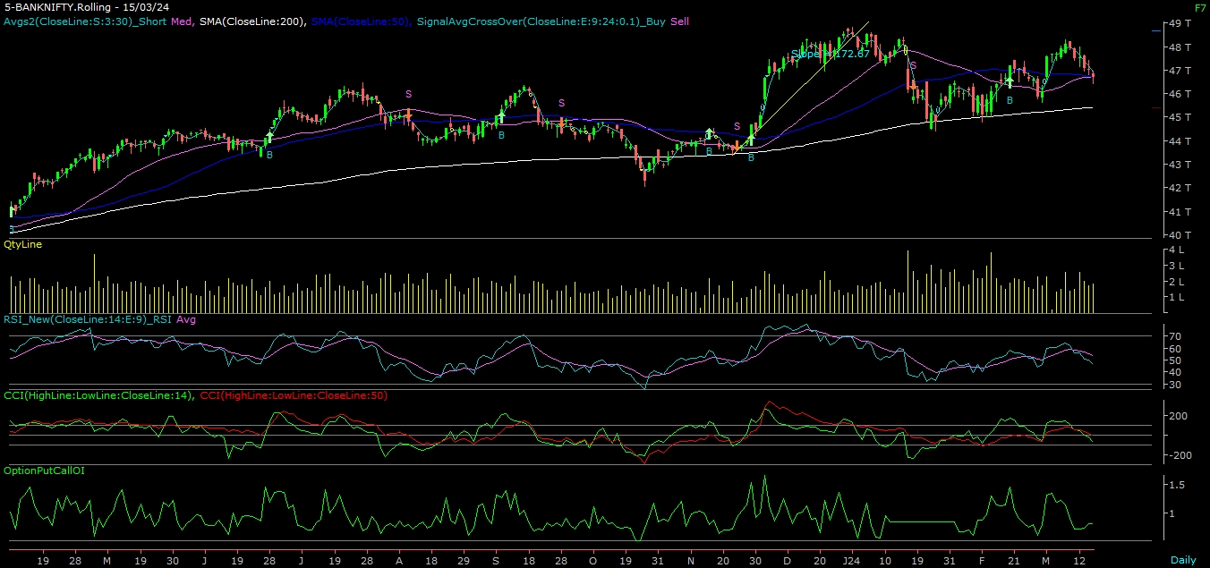
BANK NIFTY

Slide 7
FINAL SUMMARY
NIFTY BANK NIFTY
Resistance – 22150-22300 Resistance – 46850 - 47050
Support – 21800-21650 Support – 46300 - 46100

