Slide 1



Slide 2

WEEKLY NIFTY & BANK NIFTY VIEW
Presented By-Mr. Ratnesh Goyal
(Sr. Technical Analyst)

Slide 3

NIFTY OUTLOOK
If we look at the daily chart of Nifty, we are observing a series of “Narrow range body formation and on the weekly chart we are observing “ prices tested short-term moving averages”, If we analyze both chart patterns it indicates, we may see stocks specific action will remain continue and adopt buying on deep strategy. if Nifty starts trading above the 23,550 level, then it can touch the 23,750-23,950 level, while on the downside, support is 23,300 and if it starts to trade below then it can test the level 23,100 and 22,800 levels.

Slide 4
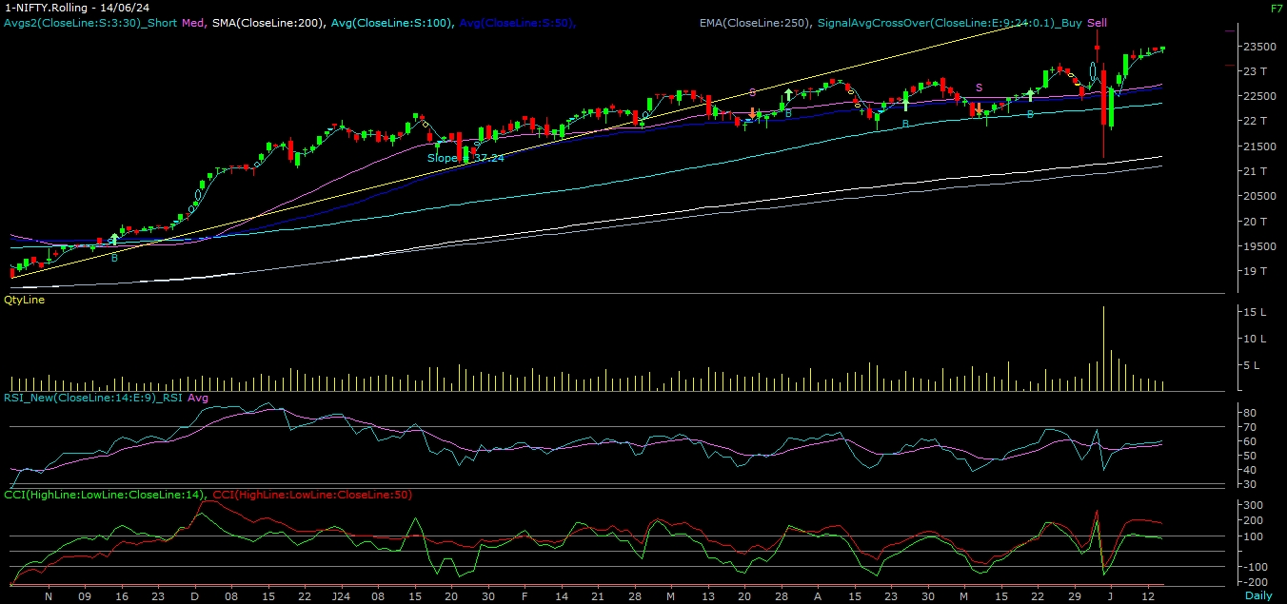
NIFTY

Slide 5
NIFTY BANK OUTLOOK
If we look at the daily chart of Bank-Nifty, we are observing a “ series of Narrow range body formation” and on the weekly chart “Doji” candlestick formation, if we analyze both chart patterns it indicates Bank-nifty can also trade with positive bias & use buy on deep strategy. Bank-nifty starts trades above 50,200 then it can touch 50,450 and 50,750 levels. However, downside support comes at 49,800, and below that, we can see 49,650 and 49,500 levels.

Slide 6
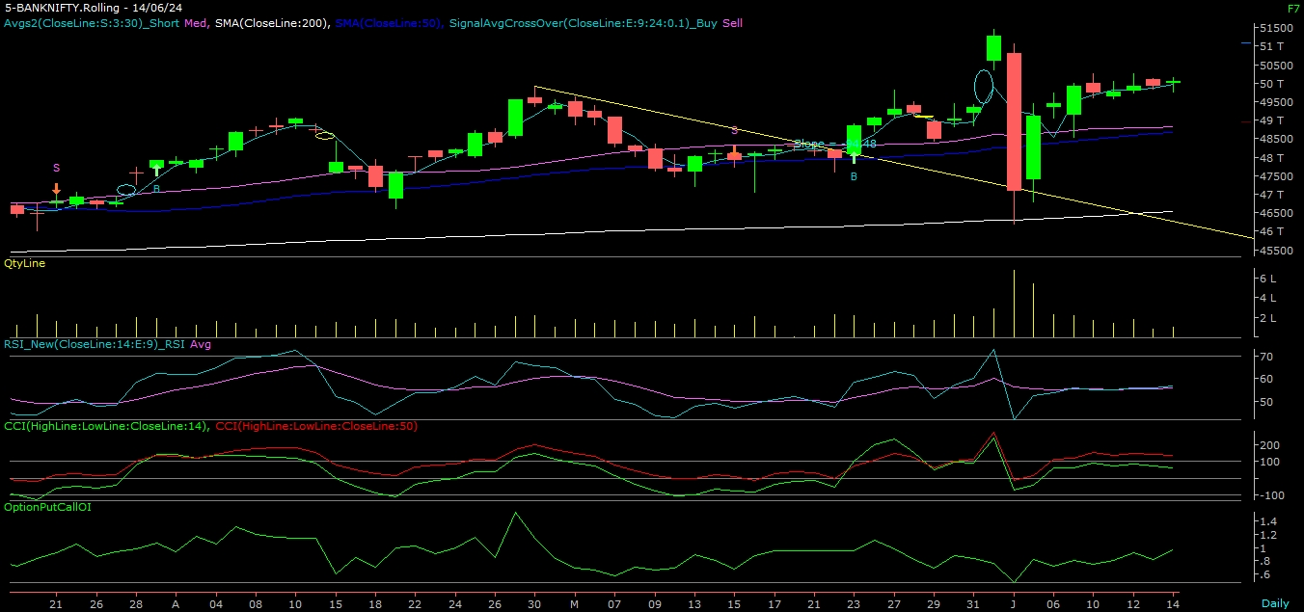
BANK NIFTY

Slide 7
FINAL SUMMARY
NIFTY BANK NIFTY
Resistance – 23750-23950 Resistance – 50450 - 50750
Support – 23100-22800 Support – 49650 - 49500

