Slide 1



Slide 2

WEEKLY NIFTY & BANK NIFTY VIEW
Presented By-Mr. Ratnesh Goyal
(Sr. Technical Analyst)

Slide 3

NIFTY OUTLOOK
If we look at the daily chart of Nifty, we are observing a series of “Narrow-range body formations, and on the weekly chart we are observing “ Doji” candlestick formation, If we analyze both chart patterns it indicates, that we may see stocks specific action will remain to continue and adopt buying on deep strategy. if Nifty starts trading above the 23,550 level, then it can touch the 23,750-23,950 level, while on the downside, support is 23,300 and if it starts to trade below then it can test the level 23,100 and 22,800 levels.

Slide 4
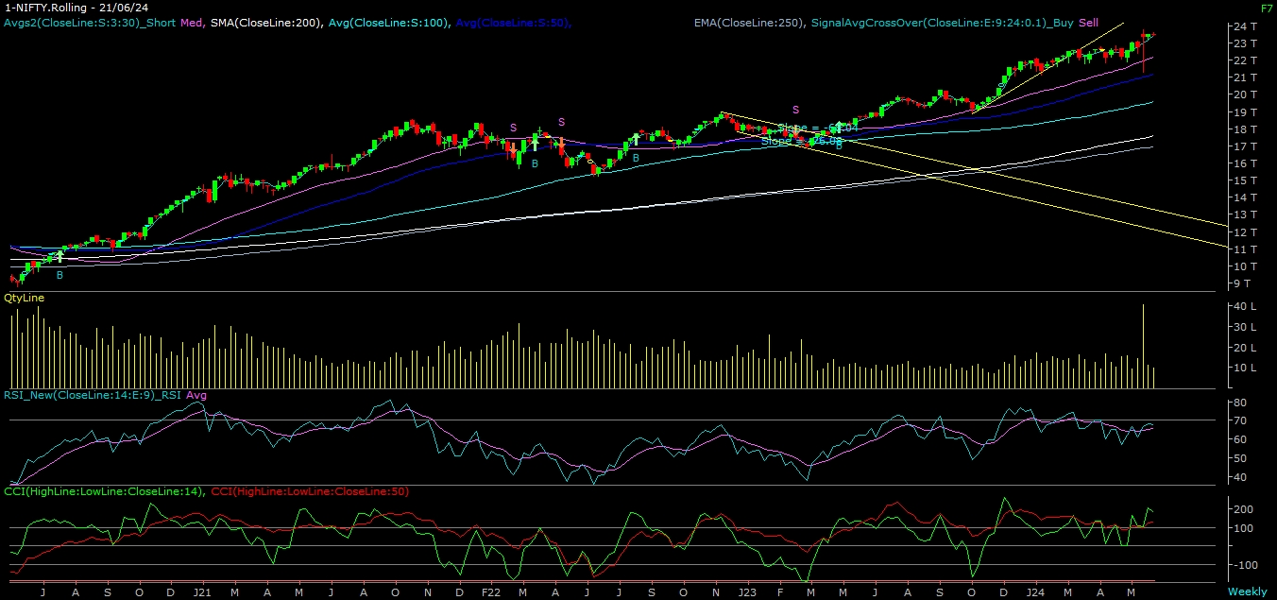
NIFTY

Slide 5
NIFTY BANK OUTLOOK
If we look at the daily chart of Bank-Nifty, we are observing a “Breakout of Trendline” and on the weekly chart “Bullish” candlestick formation, if we analyze both chart patterns it indicates Bank-nifty can also trade with positive bias & use buy on deep strategy. Bank-nifty starts trades above 51,800 then it can touch 52,050 and 52,400 levels. However, downside support comes at 51,300, and below that, we can see 51,100 and 50,500 levels.

Slide 6
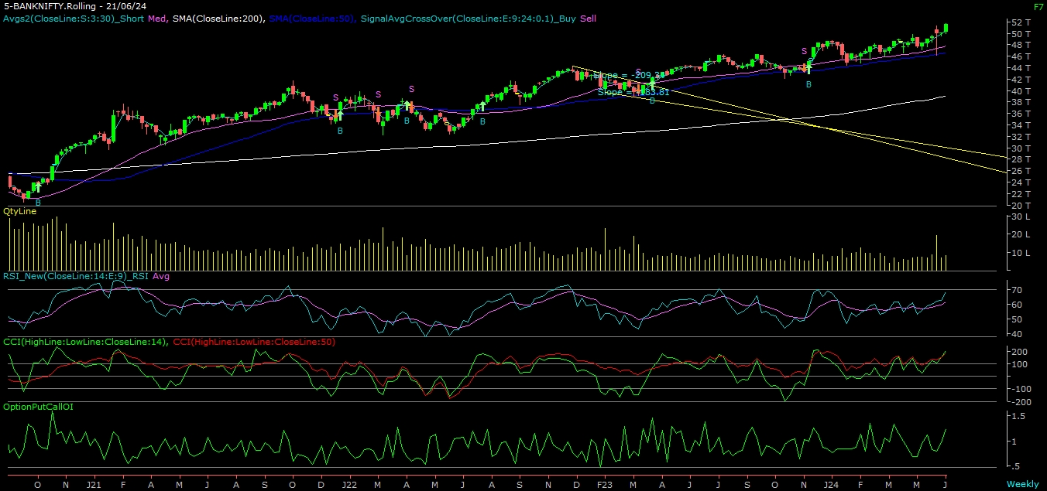
BANK NIFTY

Slide 7
FINAL SUMMARY
NIFTY BANK NIFTY Resistance – 23750-23950 Resistance – 52050 - 52400
Support – 23100-22800 Support – 51100 - 50500

