Slide 1



Slide 2

WEEKLY NIFTY & BANK NIFTY VIEW
Presented By-Mr. Ratnesh Goyal
(Sr. Technical Analyst)

Slide 3

NIFTY OUTLOOK
If we look at the daily chart of Nifty we are observing a “Bearish candlestick” formation and on the weekly chart we are observing a “Doji” candlestick formation If we analyze both chart pattern it indicate, we will remain volatile and we can see some supply from higher levels. if Nifty starts trading above the 22,520 level, then it can touch the 22,650-22,750 level, while on the downside, support is 22,300 and if it starts to trade below then it can test the level 22,100 and 21,900 levels.

Slide 4
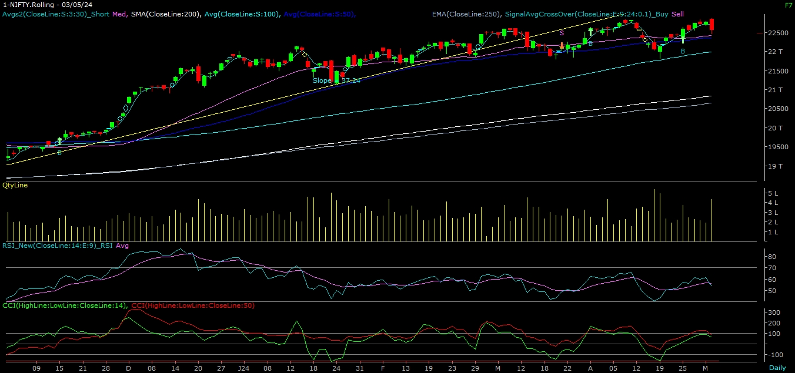
NIFTY

Slide 5
NIFTY BANK OUTLOOK
If we look at the daily chart of Bank-Nifty, we are observing prices trading far away from long-term moving averages, and on the weekly chart we are observing a “Shooting Star” candlestick formation, if we analyze both chart patterns it indicates Bank-nifty will also remain volatile and can face supply at higher levels. Bank-nifty starts trades above 49,100 then it can touch 49,500 and 49,800 levels. However, downside support comes at 48,500, and below that, we can see 48,300 and 48,100 levels.

Slide 6
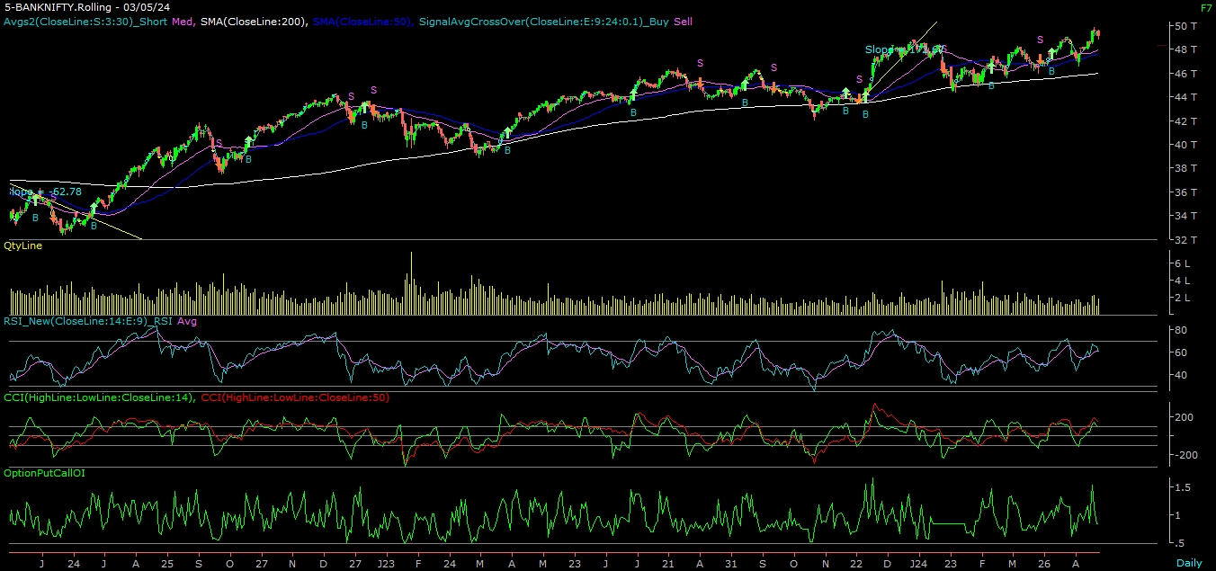
BANK NIFTY

Slide 7
FINAL SUMMARY
NIFTY BANK NIFTY
Resistance – 22650-22750 Resistance – 49500 - 49800
Support – 22100-21900 Support – 48300 - 48100

