Slide 1



Slide 2

WEEKLY NIFTY & BANK NIFTY VIEW
Presented By-Mr. Ratnesh Goyal
(Sr. Technical Analyst)

Slide 3

NIFTY OUTLOOK
If we look at the daily chart of Nifty we are observing prices taken support at 50DAY moving averages and on the weekly chart we are observing “ Doji candlestick, If we analyze both chart patterns it indicates we will remain consolidated, but still stocks specific action may remain continue. if Nifty starts trading above the 22,150 level, then it can touch the 22,250-22,350 level, while on the downside, support is 21,950 and if it starts to trade below then it can test the level 21,800 and 21,650 levels.

Slide 4
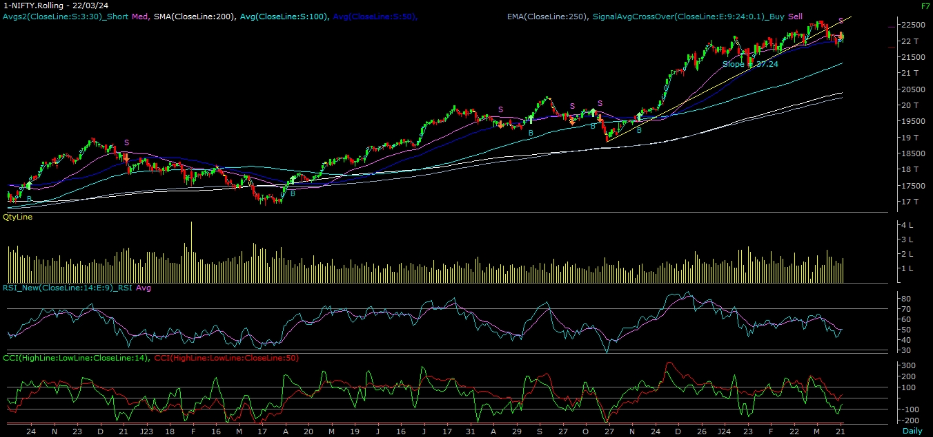
NIFTY

Slide 5
NIFTY BANK OUTLOOK
If we look at the daily chart of Bank-Nifty, we are observing prices close above the 50Day moving average and on the weekly chart trading above “Short-term “ moving averages, if we analyze both chart pattern it indicates now in Bank-nifty we may see some positive movement. Bank-nifty starts trades above 46,950 then it can touch 47,150 and 47,350 levels. However, downside support comes at 46,700, and below that, we can see 46,500 and 46,300 levels.

Slide 6
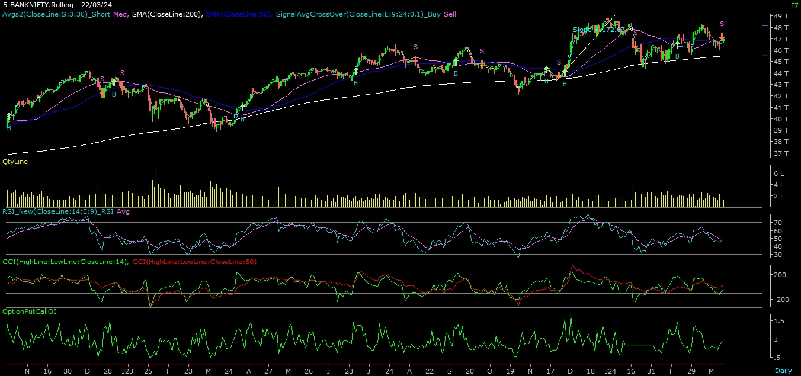
BANK NIFTY

Slide 7
FINAL SUMMARY
NIFTY BANK NIFTY Resistance – 22250-22350 Resistance – 47150 - 47350
Support – 21800-21650 Support – 46500 - 46300

